Slide 1
S PRESENTATION
Real-Time Emotion Detection
System Using Artificial Intelligence
AI Course — Unit V
Facial Expression Analysis · Computer Vision · Deep Learning
AI SCAN
VISHAL P (192512340)
AI Course – Unit V | Real-Time Emotion Detection System
1

Slide 2
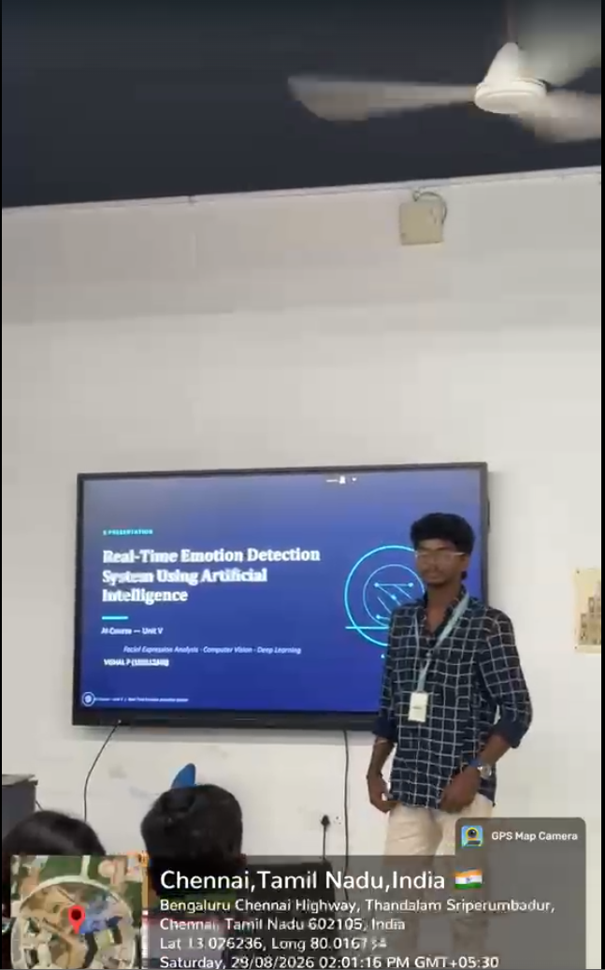

Slide 3






Introduction
Understanding emotion detection through AI
What is Emotion Detection?
Six Core Emotions
The process of identifying a person’s emotional state using visual, vocal, or physiological signals.
Recognized from facial expressions
Facial Emotion Recognition
A branch of emotion detection that uses facial expressions captured by a camera to infer emotion.
Happy
Sad
How AI Identifies Emotion
AI analyzes facial features — eyes, eyebrows, mouth — and matches patterns learned from training data.
Angry
Fear
Why Real-Time Matters
Instant feedback enables systems to react immediately — improving learning, healthcare monitoring, and human-computer interaction as emotions happen.
Surprise
Neutral
AI Course – Unit V | Real-Time Emotion Detection System
2

Slide 4






Working Principle
How the system processes a face from camera to result
1
2
3
4
5
6
▸
▸
▸
▸
▸
Camera
Face Detection
Preprocessing
AI / Deep
Learning Model
Emotion
Classification
Result
Captures live video feed of the user’s face.
Locates the face region within each frame.
Crops, aligns, resizes, and normalizes the face.
A trained CNN analyzes facial features.
Assigns probabilities to each emotion class.
Displays the predicted emotion in real time.
3

Slide 5











Technologies & AI Model
The tools and techniques behind the system
Camera / Webcam
Python
CNN Architecture (Simplified)
OpenCV
Machine / Deep Learning
→
→
→
→
CNN
Feature Extraction
Input
Image
Conv.
Layers
Pooling
Fully
Connected
Emotion
Output
The CNN automatically learns discriminative facial patterns — edges, textures, and shapes — across multiple layers, replacing manual feature engineering.
Real-Time Prediction
6
≈ 30 fps
48×48
Emotion
Classes
Typical
Frame Rate
Common Input
Size (px)
AI Course – Unit V | Real-Time Emotion Detection System
4

Slide 6






Real-World Applications
Where emotion detection creates real value
Education
Healthcare
Customer Service
Understanding student engagement and attention during class.
Assisting in emotion and mood monitoring for patient care.
Analyzing customer reactions to improve service quality.
Human–Computer Interaction
Smart Systems & Assistants
Security
Making digital systems respond naturally to users.
Enabling emotionally aware AI assistants and devices.
Supporting user authentication and behavior monitoring.
AI Course – Unit V | Real-Time Emotion Detection System
5

Slide 7


Advantages, Limitations & Conclusion
Advantages
Limitations
Real-time analysis of facial expressions
Lighting and camera quality affect accuracy
Automatic emotion classification
Facial expressions can be ambiguous
Fast and completely contactless
Privacy concerns around facial data
Useful foundation for intelligent systems
AI models may carry inherent bias
Conclusion
Real-time emotion detection combines computer vision and AI to understand human facial expressions — paving the way for more intelligent and interactive future systems.
AI Course – Unit V | Real-Time Emotion Detection System
6

